Slide 1
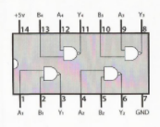
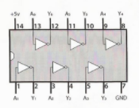
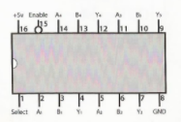
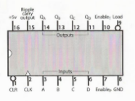
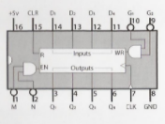
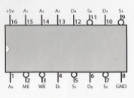
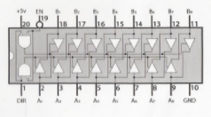
Ben Eater’s 8 Bit Computer
MAR and RAM IC PINOUTS
74LS00:
NAND gate
74LS04:
Inverter
74LS157:
2-to-1 line selector
74LS161:
4-bit binary counter
74LS173:
4-bit D register
74LS189:
64-bit RAM
74LS245:
8-bit bus transceiver

